Slide 1

Data SCIENCE what it is?
Xin Tang
Notes:
NOTE: Want a different image on this slide? Select the picture and delete it. Now click the Pictures icon in the placeholder to insert your own image.

Slide 2
DATA SCIENCE is HOT
Majority universities in USA provide data science degree
Big Tech company like google, META pay top notch salary for anyone play with data
"Data Analysis is the golden ticket " (quote from Kristina)
Employment of data scientists is projected to grow 36 percent from 2021 to 2031 (per google)
Then, WHAT EXACTLY IS DATA SCIENCE ?

Slide 3
What comes to your mind when thinking of data science?
Algorithms
Programming
Artificial Intelligence
Machine learning
Big Data
Smart Ad?

Slide 4
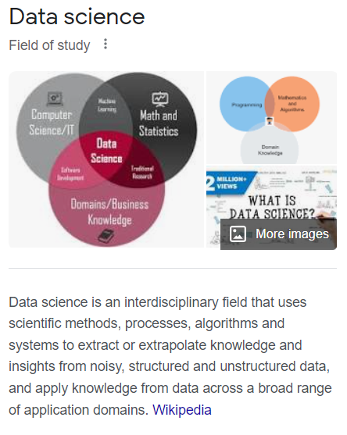
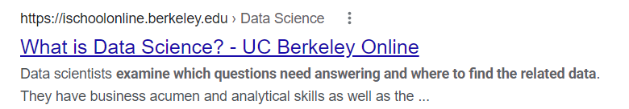
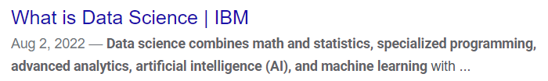

DATA SCIENCE defined by big company and wiki

Slide 5
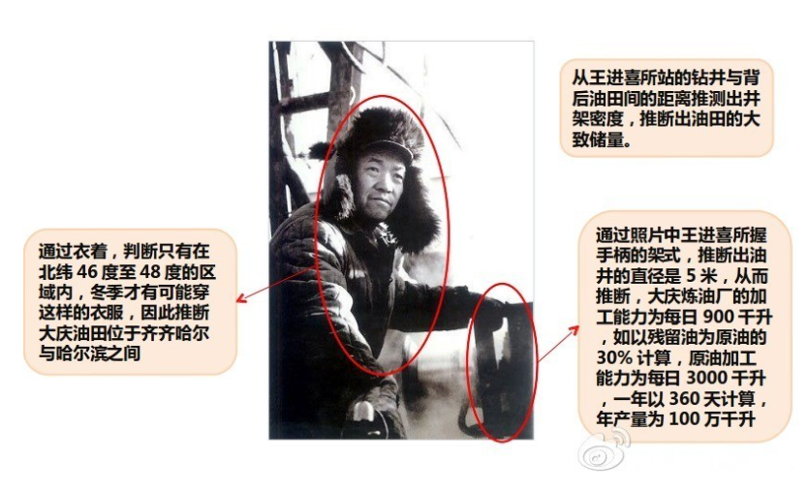
Data Science Example 1: data science is before computer era
In 1964, Japan intelligence agency found a news report with this picture from China public newspaper, from the picture they successfully identify the location of the crude oil field and even estimated production capacity. Mitsubishi quickly prepare the equipment fit for production condition at that location and made a big sale to China.
Picture from internet

Slide 6
Data Science Example 2: data science can from people's experience
What makes data science intuitive? At its core, data science is about spotting patterns and predicting how one variable will affect another, people do this all the time.
My grandmother gave me relationship advice, she utilized the large database of relationship that her brain has uploaded over a near century of life..... she limited her analysis to a sample of relationships in which that man had many qualities that I have.... she correlated these key qualities of the woman with a key quality of the relationship
(From book: Everybody lies by Seth)

Slide 7
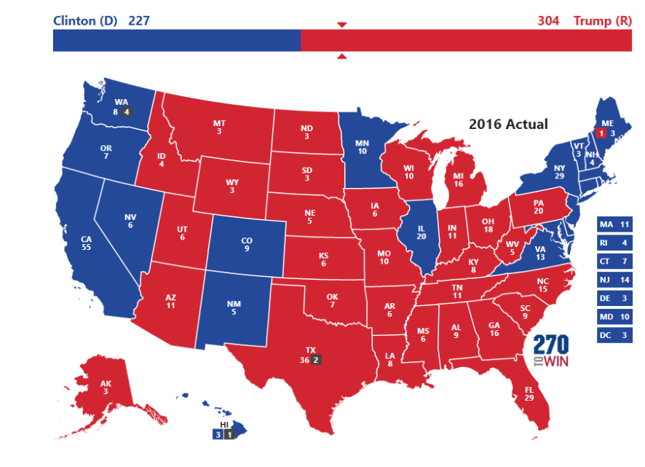
Data Science Example 3: Data tells different story from obvious
In 2016 President election, all major medias and surveys predicted Mrs. Clinton would win, especially with the support from black. But google search data showed a different story, that Trump had more support. which turn out to be the result. (book: Everybody lies by seth)
Picture from internet

Slide 8
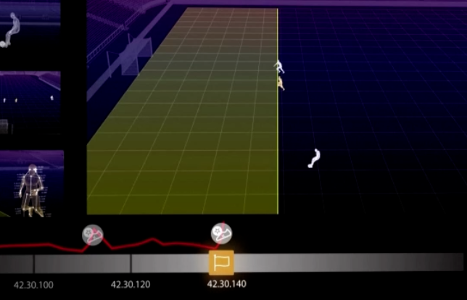
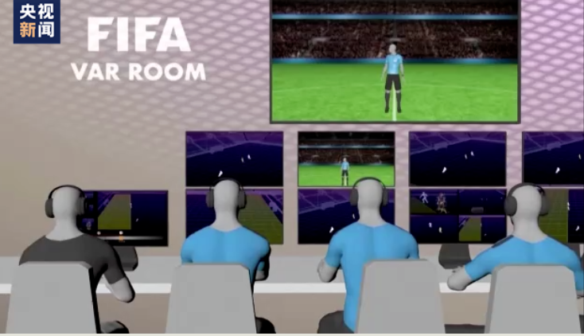
Data Science example 4: data can be used for no tech area
In FIFA world cup 2022, a computer aided semi-automated offside detection technology is deployed. The computer uses data from camera, calculates each player position and detect the offside in few seconds, then render it to a simulated replay.
VAR detected offside in all games played so far.
Picture from internet

Slide 9
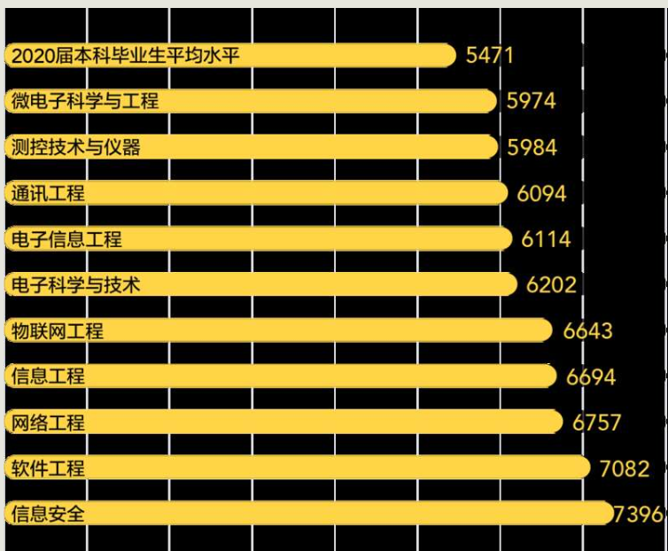
Data Science example 5: Data means money and opportunities
In China, Student need to specify the major and college after taking the nation-wide standard college entry test, it cannot be changed once submitted. The score is the dominating factor to determine the admission
College planning companies are using big data to predict targeted college admission scores and most profitable majors, then provide paid suggestions to anxious parents and students.
Picture from internet

Slide 10
Conclusion
Data science could be as natural as everyone' s experience and can be complicated as Artificial Intelligence.
Data science is not new, but the tools, methods and process are new
Data science can create business and non-business opportunities
Data science can discover unknown which maybe contradict to the obvious.
Data science needs to yield narrative results to help making decisions.
The possibilities of data science depend on what unknown you want to discover!

